Slide 1
Searching Binary Data in SQL Server 2012
Steve Jones
SQLServerCentral.com

Slide 2
Agenda
Binary Data
Full Text in SQL Server 2012
Basic Searches
Semantic Search

Slide 3
Agenda
Binary Data
Full Text in SQL Server 2012
Basic Searches
Semantic Search
Notes:
Let’s first talk about binary data and what it is

Slide 4
Binary Data
Types of data
Structured (normal, RDBMS tables)
Semi-structured (XML)
Unstructured (BLOBs, music, images, documents)
Notes:
There are three types of data we work with in SQL Server. Structured, semi-structured, and unstructured. These are broken down mostly by metadata

Slide 5
Binary Data
Demo
Notes:
Let’s see how this list would exist as structured or semi-structured data.

Slide 6
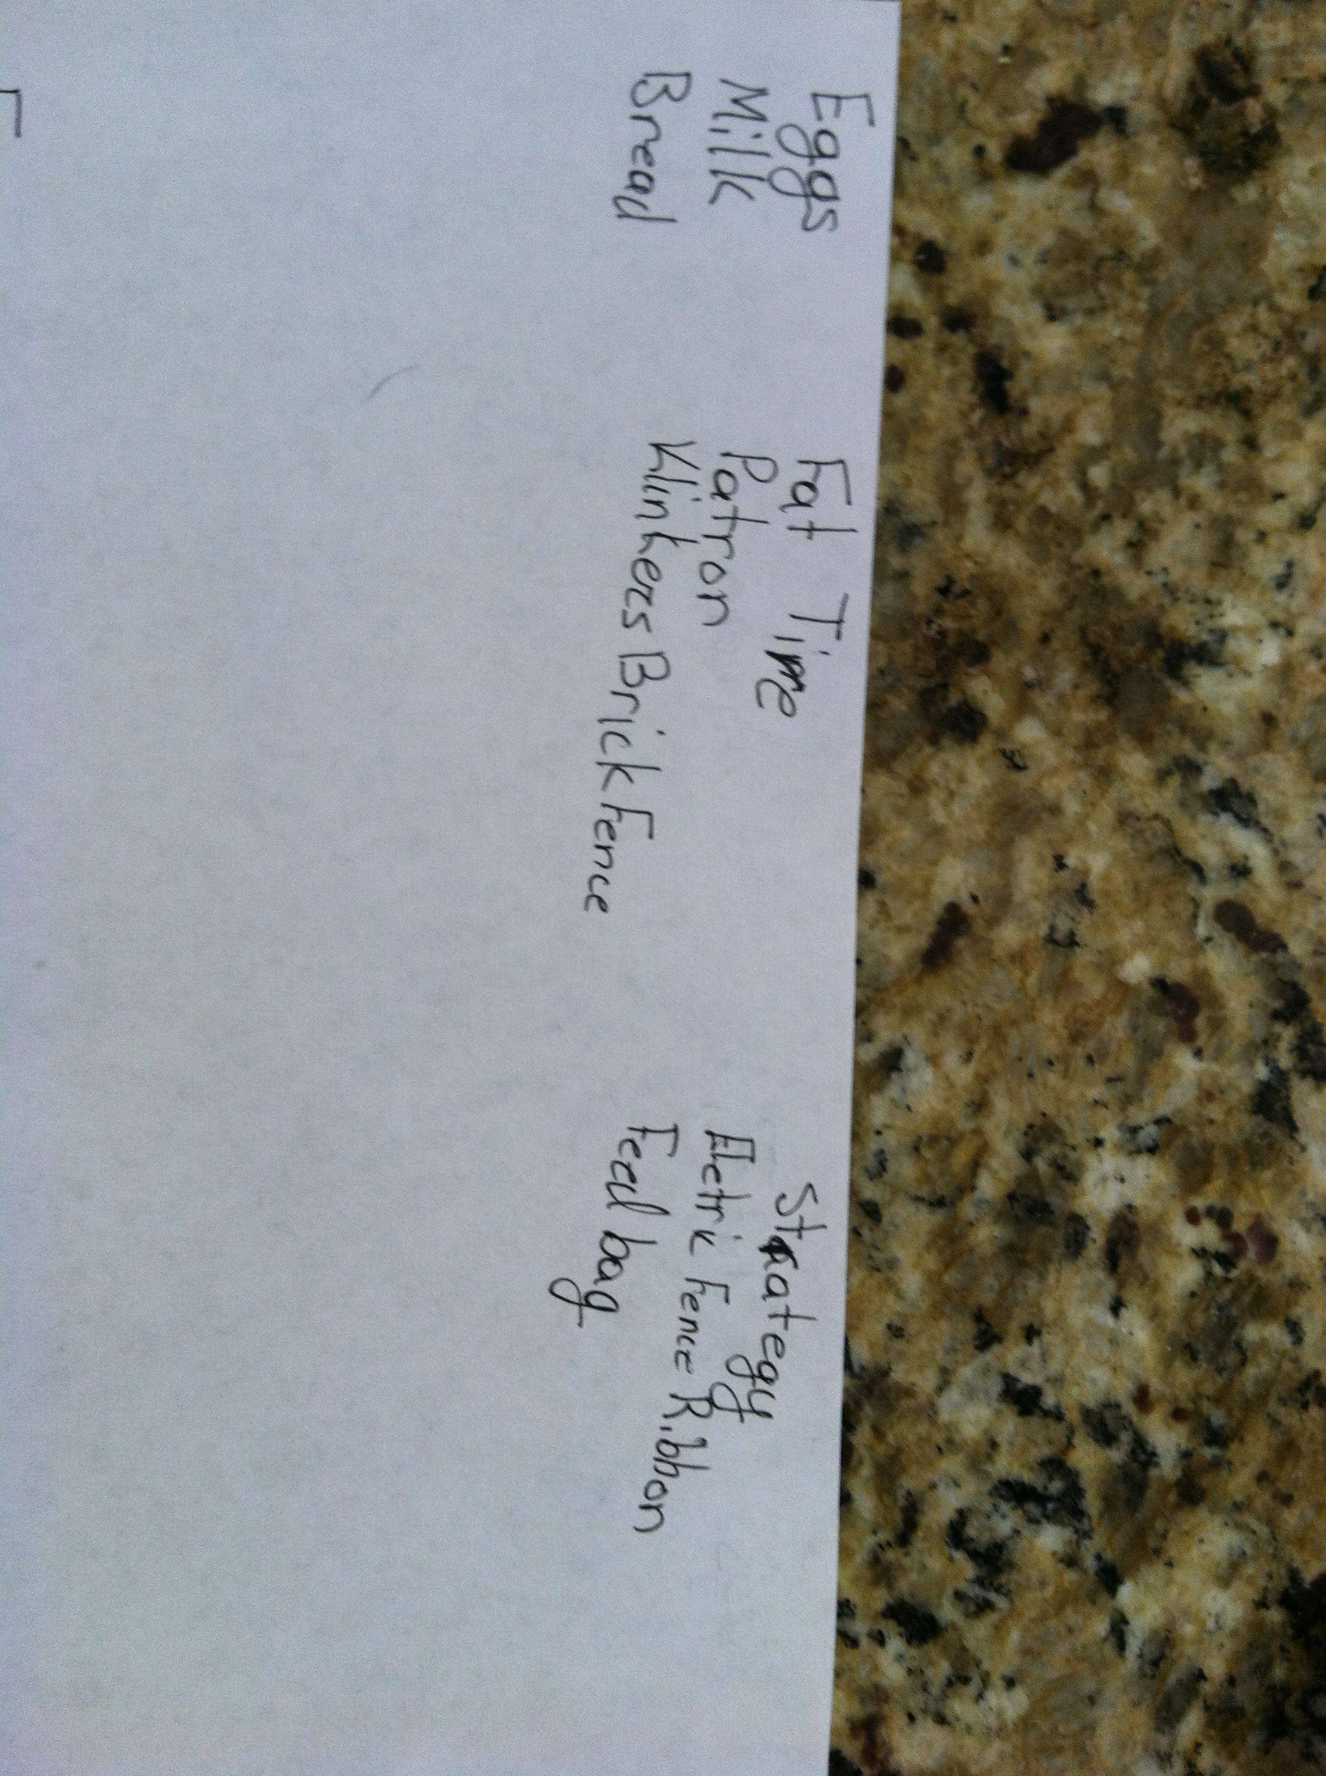
Binary Data
Notes:
Typically I take a picture of my lists. It’s easier for me, and it’s easy for my wife to send me a picture if I’m out. What I’d like is the list broken down like this, which gives me some ordering to the items. There’s some metadata included in this picture just by the physical ordering.

Slide 7
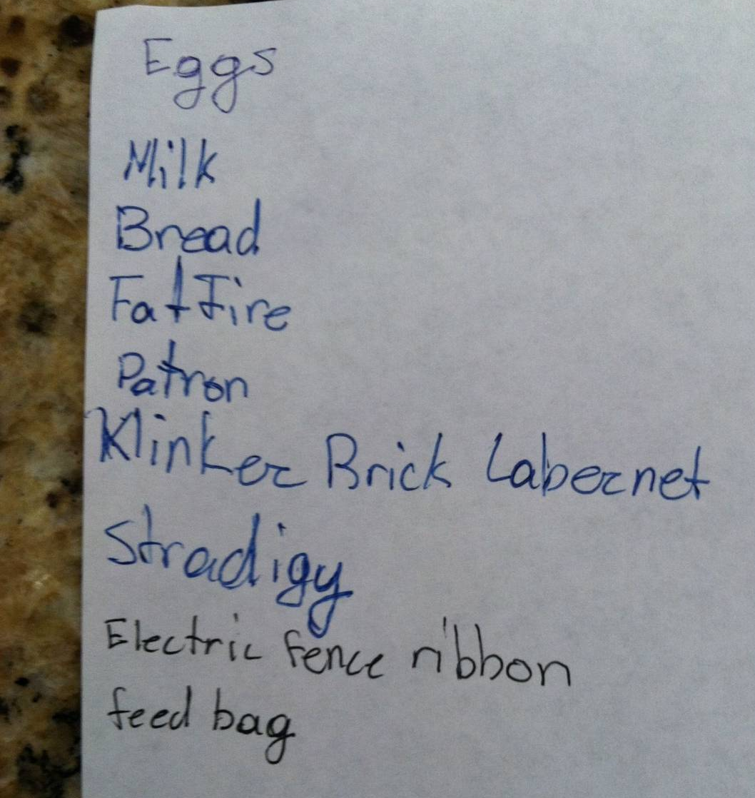
Binary Data
Notes:
What I usually get is this, and I have to parse things out for myself.

Slide 8
Binary Data
Unstructured data in SQL Server
Notes, memos?
XML
Varchar(max)/varbinary(max)
Filestream
Filetable
Notes:
Why talk about unstructured data? Often it can be binary data stored in your system in any of these ways. Notes/memos are usually text, but they can be formatted as rich text or some other format. People may load EXCEL or WORD documents into a varchar(max) field. We also have Filestream and FileTable structures..

Slide 9
Filestream
Introduced in SQL Server 2008
Improves management of file-like data by integrating backup/restore/transactions
Improves performance by storing the data in the file system.
Ex: AdventureWorks.Production.Document
Notes:
Filestream was added in SQL Server 2008 and was the first attempt to make binary data handling easier to manage while improving performance.

Slide 10
FileTable
New in SQL Server 2012
Built on Filestream
Allows a folder to appear as a table
Explorer style access to the table
Avoids complex programming to access Filestream data.
Notes:
File table is new in SQL Server 2012. It builds on Filestream, and requires Filestream to be enabled. Instead of using Win32 APIs for access outside of T-SQL, this allows normal Explorer type access for data in the table. In this case we can use all the normal drag drop, Powershell, VBScript, etc. access for files that we use in any Windows file operation.
More about this later. We will show this in the demo

Slide 11
Agenda
Binary Data
Full Text in SQL Server 2012
Basic Searches
Semantic Search
Notes:
Let’s move on to Full Text Search in 2012

Slide 12
Full Text in SQL Server 2012
Major rewrite of Full Text Indexing and Search in SQL Server 2008.
FTS -> iFTS
Process is now integrated inside SQL Server
Sqlservr.exe (searching)
Fdhost.exe (filters)
Index stored as an internal table
Backup/restore now integrated
Notes:
This changed substantially in SQL Server 2008. It has continued to be enhanced in 2012. It was originally renamed Integrated Full Text Search, but it has gone back to just full-text search. Instead of the old Microsoft Search service and a separate service it is now integrated into the SQL Server core process. Indexes are stored inside SQL Server, which means they are internal tables and included in backup/restore, and other administrative functions.

Slide 13
Full Text in SQL Server 2012
Performance increases
Better scalability (350mm), parallelism, indexing
Max full-text crawl range (CPU)
Master merge DOP
New languages (Czech, Greek)
New word breakers/stemmers
Property Lists
Customizable NEAR
Notes:
In 2012 we have a number of new features. The performance of FTS in 2012 has been improved, with more parallelism, better indexing, and scales to 350mm documents in an index. That was the test level. You can also set limits on the indexing process. New languages have been added and a number of new word breakers and stemmers, including US English ones. Property lists were added as searchable entities in the iFitlers and the NEAR operator is now customizable.

Slide 14
Full Text in SQL Server 2012
Word breakers
Stemmers
Stoplists
Thesaurus file
Notes:
Let’s talk about a few components in FTS. Word Breakers exist for most major languages and determine word boundaries and apply the lexical rules to the tokens, or words used in the FTS index. The words are stored as these tokens to save space in the index.
Stemmers conjugate verbs and generate inflectional forms of words. For example, in a document, “run” also matches “running”, “ran”, “runner” and more.
Stoplists used to be called noise words. These are words ignored in the searching “the”, “a”, “an” and other parts of our language are not usually searched on.
The Thesaurus file is an XML file that contains substitutions and replacements for words in an index. Here’s an example.

Slide 15
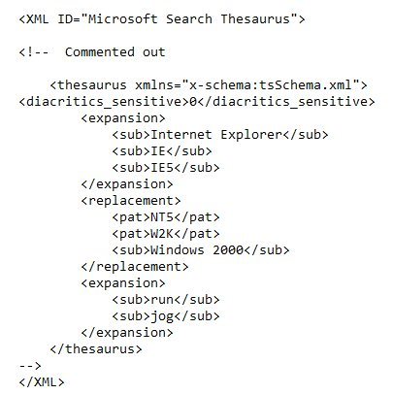
Notes:
Here is the thesaurus file that comes with SQL Server. It’s basic, and if there are specific terms needed in this area, you need to manage the file yourself.
The file is: C:\Program Files\Microsoft SQL Server\MSSQL11.MSSQLSERVER\MSSQL\FTData
Files for each language.
Expansion – provide synonyms for words.
Replacement -

Slide 16
Full Text in SQL Server 2012
Full Text Search Programming
CONTAINS
CONTAINSTABLE
FREETEXT
FREETEXTTABLE
Language specific searches
multi-language – use UNION
Some objects do not allow FTS

Slide 17
Agenda
Binary Data
Full Text in SQL Server 2012
Basic Searches
Semantic Search

Slide 18
iFilters
iFilters
Filter to allow you to search the content of unstructured data.
Standard format (iFilter Interface)
Basic Office 2007 filters included.
Download pdf, Office 2010 filters

Slide 19
Searching Binary Data
Searching really requires Full Text Search subsystem.
Need iFilters to ignore the metadata

Slide 20
Searching Binary Data
Property Lists
Allow searches of standard properties for documents
i.e. Title, Name, Author, etc.
Can be varbinary/image or Filestream documents
Troubleshoot TF 7603

Slide 21
Searching Binary Data
demo

Slide 22
Agenda
Binary Data
Full Text in SQL Server 2012
Basic Searches
Semantic Search

Slide 23
Semantic Search
New in 2012 – V1.0
Find the meaning of the documents and use that for matching.
Not just keywords

Slide 24
Semantic Search
Semantics (from Greek: sēmantiká, neuter plural of sēmantikós)^{[1][2]} is the study of meaning. It focuses on the relation between signifiers, such as words, phrases, signs, and symbols, and what they stand for, their denotata.

Slide 25
Semantic Search
How does this work?
TF-IDF (term frequency - inverse document frequency)
Document Similarity Index
Cosine similarity algorithm
Based on “keyword distribution in the language”

Slide 26
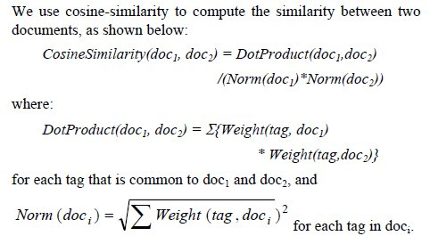
Semantic Search

Slide 27
Semantic Search
SQL Server 2012
Need to use semanticsdb from Microsoft
Set of phrases for each language
Hard coded (no learning!)
Only unigrams in SQL Server 2012
Look for ngrams in the future

Slide 28
Semantic Search
Query Plans
Need to use Extended Events
Fulltext_query_Exec_stats

Slide 29
Semantic Search
demo

Slide 30
The End
Questions?
Please fill out your evaluations
www.sqlservercentral.com/forums
www.voiceofthedba.com/talks

Slide 31
References
Full Text Search - http://msdn.microsoft.com/en-us/library/ms142571
What’s New - http://msdn.microsoft.com/en-us/library/cc645577
Behavior Changes to Full Text Search - http://msdn.microsoft.com/en-us/library/ms143272.aspx
Breaking Changes in Full Text Search - http://msdn.microsoft.com/en-us/library/ms143709.aspx
Sp_fulltext_service - http://msdn.microsoft.com/en-us/library/ms175058.aspx

Slide 32
References
iFilter Interface - http://msdn.microsoft.com/en-us/library/ms691105%28v=vs.85%29.aspx
Office 2012 Filter Pack - http://www.microsoft.com/en-us/download/details.aspx?id=17062
How to register filter packs in SQL Server - http://support.microsoft.com/kb/945934
Adobe PDF iFilter - http://www.adobe.com/support/downloads/detail.jsp?ftpID=2611

Slide 33
References
Find Property Set GUIDs and Property Integer IDs for Search Properties - http://msdn.microsoft.com/en-us/library/ee677618
Configure and Manage Word Breakers and Stemmers for Search - http://msdn.microsoft.com/en-us/library/ms142509
Configure and Manage Stopwords and Stoplists for Full-Text Search - http://msdn.microsoft.com/en-us/library/ms142551
Configure and Manage Thesaurus Files for Full-Text Search - http://msdn.microsoft.com/en-us/library/ms142491

Slide 34
References
Semantic Search – http://msdn.microsoft.com/en-us/library/gg492075
Beyond Relational – Semantic Search - http://blogs.technet.com/b/andrew/archive/2011/09/06/beyond-relational-semantic-search-with-sql-server-filetable.aspx
MySemanticSearch – Codeplex - http://mysemanticsearch.codeplex.com/

Slide 35
References
Full text and Semantic Search in SQL Server 2008 and 2012 - http://channel9.msdn.com/Events/TechDays/Techdays-2012-the-Netherlands/2297?format=html5
http://users.cis.fiu.edu/~lzhen001/activities/KDD2011Program/docs/p213.pdf

Slide 36
Images

